Slide 1


Special Forces Association’s
Award of Excellence Program

Slide 2
Introduction
  My name is Rick Cacini, and I will be giving an update on the Special Forces Association’s Award of Excellence Program.
  I am a member of SFA Chapter 32-50 (the Indian Nations Chapter) based in Oklahoma.
  National has assigned our Chapter the responsibility of selling and delivering the award.

Slide 3
Award Background
    The Medal and Ribbon was originally designed and created by the Los Cruces, New Mexico Chapter 80, who transferred the program to our Oklahoma Chapter in 2004.
    The award consists of a Medal and Ribbon in a gold presentation box.

Slide 4
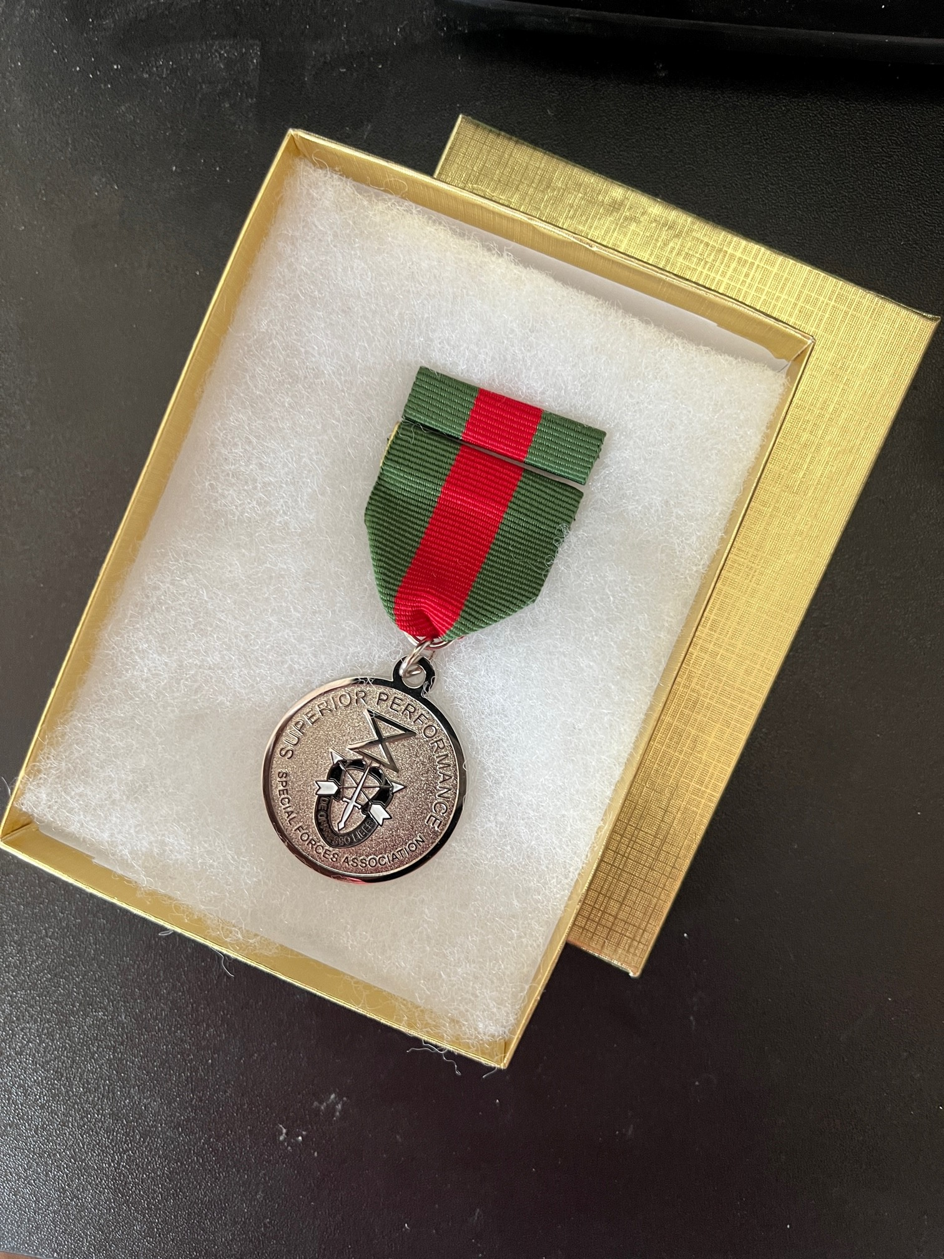
Photo of SFA Medal, Ribbon & Gold Presentation Box

Slide 5
Purpose of the Award
JROTC and ROTC programs are required to have an annual awards program.
The award is to recognize outstanding cadets in the Junior and Senior ROTC programs throughout the United States.
Our SFA Award of Excellence has become a cherished award at the annual awards program.
The recipient of the SFA Award is selected by Senior Instructors in JROTC programs and Professors of Military Science at ROTC programs.
The award is presented to a designated cadet who has been “In keeping with the Traditions and Ideals of the United States Army Special Forces Soldier’s Knowledge, Proficiency, Leadership, and Dedication to Mission.”
Our award is not limited to Army cadets, but can also be awarded in Marine, Navy, and Airforce programs as well.
Female cadets are also eligible for our award.

Slide 6
Official Recognition
The U.S. Army Cadet Command based at Fort Knox, Kentucky, oversees the JROTC and ROTC programs.
Currently, there are 3,390 JROTC programs and 1,700 ROTC programs in the United States, providing over 5,090 presentation opportunities.
Recently, Cadet Command officially approved the awarding and wearing our Special Forces Association’s Award of Excellence.
The official approval has been published on page XXX of the USACC Reg 672-5-1.

Slide 7
Chapter Participation
Many SFA Chapters are currently participating in the awards program; in fact, 29 Chapters have placed orders for 301 medals so far in 2022.
Since there are currently 87 Chapters, that means that 33% of our Chapters participated in the program this year.
Since there have been 512 medals ordered, that means about 17% of the 2,090 presentation opportunities were executed.

Slide 8
How to Order
Orders may be placed online or by mail.
Online orders may be placed at webpage https://greenberetrotcmedals.org/3/store.htm (Show webpage)
Online orders may be paid by credit or debit cards (Visa, Mastercard, American Express, Discover or PayPal credit cards). PayPal processes all online orders.
Orders may also be placed by mail by downloading and completing the Order Form from webpage.

Slide 9
Program Logistics
There are numerous forms that can be downloaded from the Green Berets ROTC Medals website by clicking HERE.
Most of the forms are in Microsoft Word format which allows you to modify them to fit your situation.

Slide 10
Pricing Matrix Schedule

Slide 11
Presentation Narrative
Presentation Narrative for the XXXX High School
Special Forces Association Award of Excellence
The Special Forces Association consists of current and former members of the United States Army Special Forces, commonly known as “The Green Berets.” Our primary mission is to equip, train, advise and direct indigenous forces in any area of the world during both war and peacetime to advance the cause of freedom.
The qualities required of the Special Forces Soldier are leadership, education, and the skill and ability to train others. The typical Special Forces soldier is both highly motivated and mission oriented. In addition, the Special Forces soldier must be oriented to working closely with those members of his elite team and those people of other cultures who need the education and skills Special Forces soldiers possess. The motto of Special Forces is in Latin “De Oppresso liber.” In English, that means “To Liberate or Free the Oppressed.”
As determined by this institution’s instructors, the Cadet honored here tonight has exemplified over the past school year the outstanding qualities of a Special Forces soldier --- knowledge and pursuit of excellence. Accordingly, the Special Forces Association award is for both academic and military excellence.
In keeping with our tradition of leadership, education, and training, we are pleased to present the Special Forces Association Award of Excellence to:
Cadet XXXX XXXXX

Slide 12
Sample JROTC Certificate of Excellence

Slide 13
Sample ROTC Certificate of Excellence

Slide 14
Senior Cadet – Preferred but not mandatory, but the Cadet should be “The best of the best.” A Junior Cadet may be selected if the Cadre deems no Senior Cadet is qualified. A Cadet is eligible to receive our award one time in a JROTC program or college level ROTC program. A JROTC cadet is again eligible to receive the award when they enter the ROTC program.
GPA 3.2 or above
Excels in the following characteristics.
  Physical Fitness & Bearing
  Is a fast learner
  Possesses Leadership experience & qualities
  Training & assisting or advising others
  Is a Team Player
  Knowledge & Proficiency in both tasks & subject matter
  Takes personal pride in the uniform
  Sets the Example
  Is respected by other Cadets
  Participates beyond requirements
  Exhibits confidence, but is not arrogant in demeanor
AWARD SELECTION CRITERIA

Slide 15
Mail-In Order/
Purchase Order

Slide 16
Presentation Request Form

Slide 17
Sample Sales Invoice

Slide 18
Explanation of Program (covered previously
History/Creation of Program (covered previously
Purpose of Program (covered previously
Benefits of Program
  Creates favorable & visible public image of Special Forces
  Promotes Special Forces to Cadets
  Recognizes Cadets’ achievements
  Recognizes efforts of Instructors
Steps in Establishing Program
  Step-by-Step procedures outlined in “How to Establish & Maintain an Awards Program” document posted on the Green Berets ROTC Medals website
How to Establish & Maintain an Awards Program

Slide 19
Conclusion
  Today, I have explained the
    History & Origin of the Program
    Purpose of the Program
    Benefits of the Program
    Pricing
    How to Order
    Available Website Forms
    Official Recognition of the Program
    Chapter Participation
    How to Establish & Maintain an Awards Program
  Are there any questions?
  If not, thank you for your attention and participation!

